Slide 1

Hotel Occupancy Prediction
Predictive Occupancy Modelling for Effective Linen Supply Management
Presenter Name: Anjali Dharmik
Date: 28-07-2023

Slide 2

Introduction
Background
Premier Inn, the UK's largest hotel brand, manages over 800 hotels across the country. With such a vast operation, effectively managing resources while ensuring optimal guest satisfaction is a challenging task. One of the crucial aspects of these operations is the management of linen supplies - an area where there is substantial scope for efficiency and cost savings through accurate prediction and automation.
Objective
Implement a model for hotel's final occupancy prediction three days prior to our guests' scheduled arrival.
Prepare a basic plan to deploy the solution across our extensive network of over 800 sites.

Slide 3
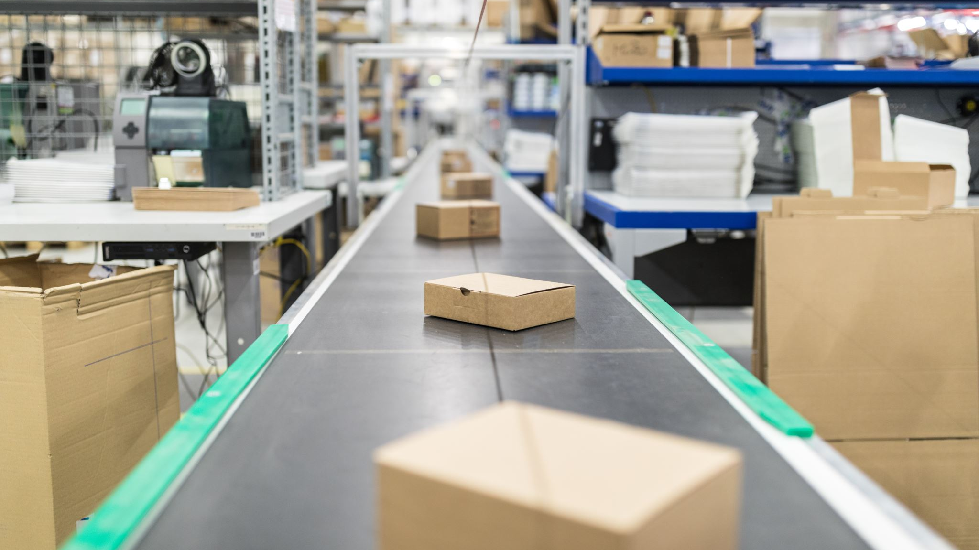
Challenges in Linen Supply Management
Overstocking
Understocking
Inefficient Linen Distribution
Impact of improper Linen Supply Management on operational costs and guest satisfaction.

Slide 4

Predictive Occupancy Modelling
Predictive Occupancy Model forecasting approach
Relevant Factors
Planning and Optimizing

Slide 5






Benefits
Improve Efficiency
Cost Savings
Better Inventory Planning
Enhanced Guest Experience
Increased Staff Productivity
Reduced waste
Optimized linen usage

Slide 6



Data Collection and Analysis
Importance of Data Collection and Data Quality
Types of data
Data Preprocessing
Feature Engineering.

Slide 7

Model Development
Implemented machine learning algorithms
Evaluation metrics : MAE, MSE, RMSE
Importance of model validation
fine-tuning for accurate predictions

Slide 8



Implementation of Model
Steps for implementing predictive occupancy model
The integration of the model
Address potential challenges and solutions during the implementation process.

Slide 9
Best Practices and Recommendations
Collect High-Quality Data
Feature Engineering
Model Selection and Comparison
Regular Model Updates
Collaboration Between Departments
Continuous Monitoring and Evaluation
Interpretability and Transparency
Data Privacy and Security
Resource Allocation
Training and Education
User Feedback and Iteration

Slide 10





Conclusion
Predictive occupancy modelling is a powerful tool for effective linen supply management in the hospitality industry.
Accurate occupancy predictions lead to optimized resource allocation, reduced costs, and improved guest satisfaction.
Implementing best practices, such as high-quality data collection and continuous model updates, ensures success.
Collaboration between departments and user feedback drive continuous improvement and model effectiveness.
Embrace data-driven decision-making and leverage predictive modelling to stay ahead in the competitive landscape.

Slide 11

Q&A Session

Slide 12
Thank you

